Slide 1

Java Programming
Introduction

Slide 2
Outline
Solving problems by Programming
Case study
What is Java?
The first java program

Slide 3


Solving problems by Programming
Problem
Result
Computational Thinking
Programming
Language
Source
code
Running
Programming & Debugging
translating
Algorithm
Program

Slide 4
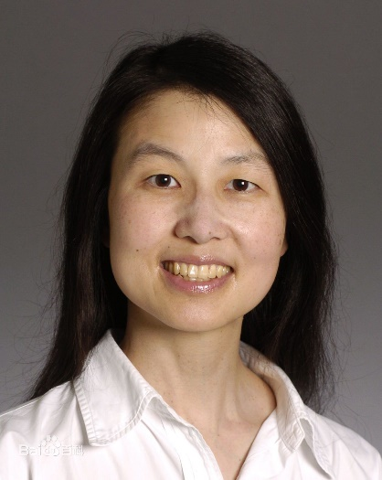
Computational thinking
Jeannette M. Wing
Corporate Vice President of Microsoft Research
Was President's Professor of Computer Science, Computer Science Department, Carnegie Mellon University
Computational thinking(计算思维) is a fundamental skill for everyone, not just for computer scientists.
Computational thinking involves solving problems, designing systems, and understanding human behavior, by drawing on the concepts fundamental to computer science.

Slide 5
Program(程序)
A program is a sequence of instructions that are executed by a CPU.
A Instruction specify how to perform a computation.
CPU instructions (or Machine Language)
They are encoded as binary numbers.

Slide 6
Instruction(指令)
Each instruction performs a very specific task, such as a load, a jump, or an ALU operation on a unit of data in a CPU register or memory.
Examples:
adding the registers 1 and 2 and placing the result in register 6 is encoded:
000000 00001 00010 00110 00000 100000
jumping to the address 1024:
000010 00000 00000 00000 10000 000000

Slide 7
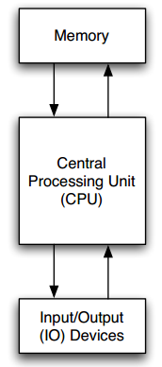
Program Execution(程序执行)
Main memory holds machine language programs and data. These are encoded as binary numbers.
The CPU fetches machine language instructions from memory one after another and executes them, which is called of fetch-and-execute cycle.

Slide 8
Programming(编程)
programming is the process of breaking down a large, complex task into smaller and smaller subtasks. The process continues until the subtasks are simple enough to be performed with the basic instructions provided by the computer.

Slide 9
Programming Language
A programming language(程序设计语言) is a formal computer language or constructed language designed to communicate instructions to a machine, particularly a computer.
Easier to understand than CPU instructions
completely unambiguous and very strict about syntax rules
Needs to be translated for the CPU to understand it

Slide 10
Programming Languages
Some basic instructions appear in every language.
input: Get data from the keyboard, a file, a sensor, or some other device.
output: Display data on the screen, or send data to a file or other device.
math: Perform basic mathematical operations like addition and division.
decisions: Check for certain conditions and execute the appropriate code.
repetition: Perform some action repeatedly, usually with some variation.

Slide 11
Source code(源代码)
Source code is any collection of programming language instructions, (possibly with comments), written using a human-readable computer language, usually as ordinary text.
Comment(注释) is a part of a program that contains information about the program but has no effect when the program runs.

Slide 12
Source code: GCD
int gcd(int K, int M) {
int k = K; // In order to state a simple, elegant loop invariant,
int m = M; // we keep the formal arguments constant and use
// local variables to do the calculations.
// loop invariant: GCD(K,M) = GCD(k,m)
while (k != m) {
if (k > m)
{ k = k-m; }
else
{ m = m-k; }
}
// At this point, GCD(K,M) = GCD(k,m) = GCD(k,k) = k
return k;
}

Slide 13
Algorithm(算法)
An algorithm is a sequence of steps that specifies how to solve a problem.
Flowchart and Pseudocode can be used represents an algorithm
Computer science is the science of algorithms, including their discovery and analysis.
The 1st algorithm: Greatest Common Divisor(GCD)

Slide 14



Flowchart(流程图)
Terminal(), the beginning and ending of a program or sub-process, Represented as a rounded rectangle
Process, a processing step, usually called activity, and denoted as a rectangle
Decision, a conditional operation that determines which one of the two paths the program will take, denoted as a diamond.
Flow line, the process's order of operation. A line coming from one symbol and pointing at another.
Notes:
https://en.wikipedia.org/wiki/Flowchart

Slide 15
Pseudocode(伪代码)
Pseudocode is an informal high-level description of the operating principle of a computer program or algorithm.

Slide 16
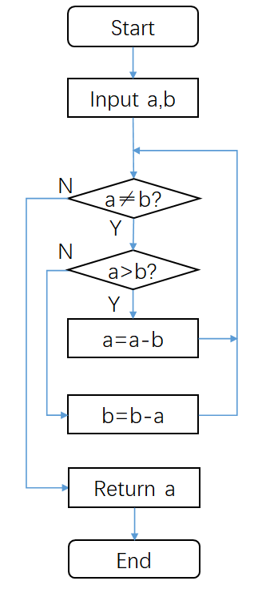
Pseudocode & Flowchart of GCD
function gcd(a, b)
while a ≠ b
if a > b
a := a − b;
else
b := b − a;
return a;

Slide 17
Translating
There are two ways to translate the source code to the program that can be executed by computers.
Compiling(编译)
This translation can be done by a program called a compiler(编译器).
compiler translates the program all at once.
Interpreting(解释)
Interpreter(解释器) translates the programming language source code instruction-by-instruction, as necessary.
An interpreter is a program that acts much like a CPU, with a kind of fetch-and-execute cycle.

Slide 18
Debugging
Designing algorithms and writing code is difficult and error-prone. For historical reasons, programming errors are called bugs, and the process of tracking them down and correcting them is called debugging.
debugging attempts to execute a program with the intent of finding bugs.
Note: The job of debugging is an iterative process as when one bug is fixed, it can illuminate other, deeper bugs, or can even create new ones.

Slide 19
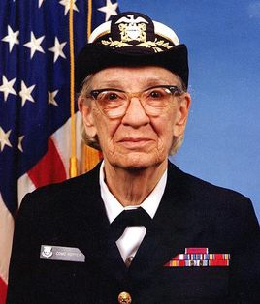
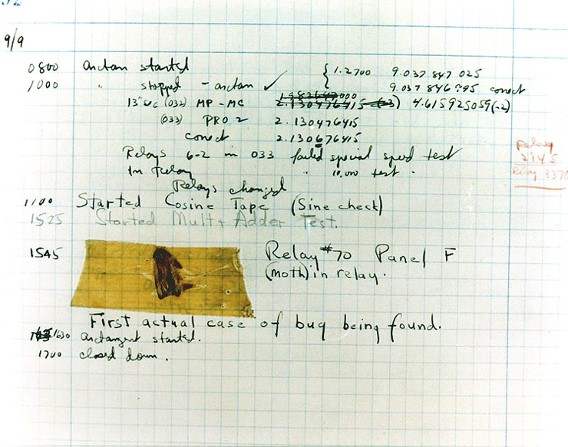
Anecdote(轶事)
In 1946, when computer scientist Grace Hopper was released from active duty, she joined the Harvard Faculty at the Computation Laboratory where she continued her work on the Mark II and Mark III. Operators traced an error in the Mark II to a moth trapped in a relay, coining the term bug. This bug was carefully removed and taped to the log book. Stemming from the first bug, today we call errors or glitches in a program a bug.
Notes:
葛丽丝·穆雷·霍普（英语：Grace Murray Hopper，1906年12月9日－1992年1月1日），本姓穆雷（Murray），霍普（Hopper）为夫姓，生于美国纽约州纽约市，美国海军准将及计算机科学家，世界上最早一批的程序员，也是最早的女性程序员之一。她创造了现代第一个编译器A-0 系统，以及商用电脑编程语言“COBOL”，被誉为COBOL之母。

Slide 20
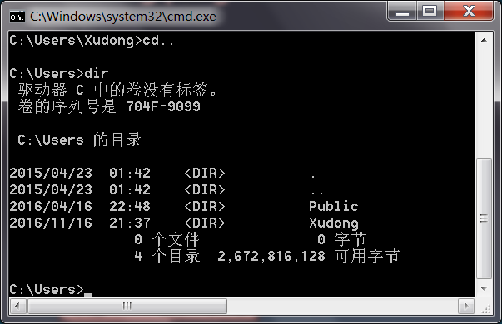
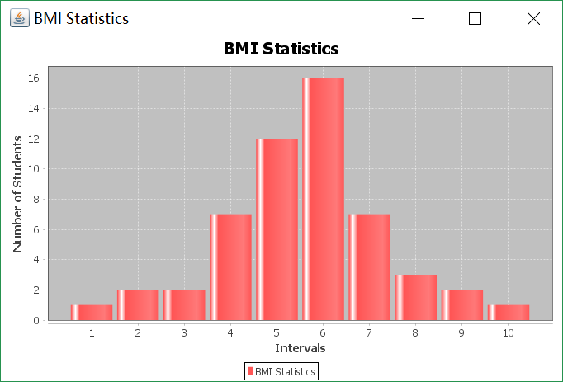
Running programs
There are two ways to interact with the programs.
CLI (command-line interface)
also known as command-line user interface, console user interface, and character user interface (CUI)
GUI (graphical user interface)
We will introduce GUI programming in the last chapter

Slide 21

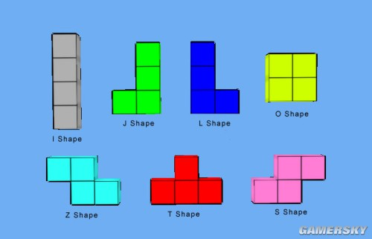
Case study
BMI Statistics
Tetris

Slide 22
BMI statistics problem
Input
Calculation
Store
Statistics
Visualization
Notes:
Input ID, name, height and weight of each student
Store the above information into a text file
Calculate the BMI of each student
Sort the student by each attribute in ASCENDING or DESCENDING order
Calculate the range, mean, media, mode the BMIs
According to the values, divide BMIs into ten same size range, and count the students in each range, lastly print the number of students in each range on the screen
Draw a histogram to show the distribution of the BMIs

Slide 23
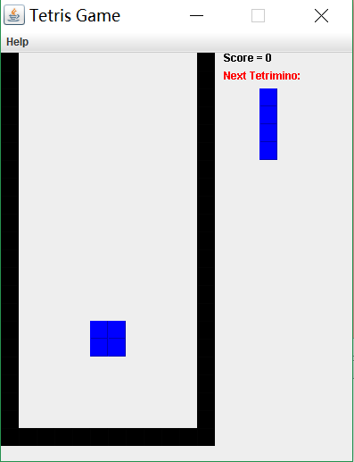
Tetris(俄罗斯方块)
Tetris is a tile-matching puzzle video game.
Notes:
The goal of Tetris is to score as many points as possible by clearing horizontal lines of Blocks. The player must rotate, move, and drop the falling Tetriminos inside the Matrix (playing field). Lines are cleared when they are filled with Blocks and have no empty spaces.

Slide 25
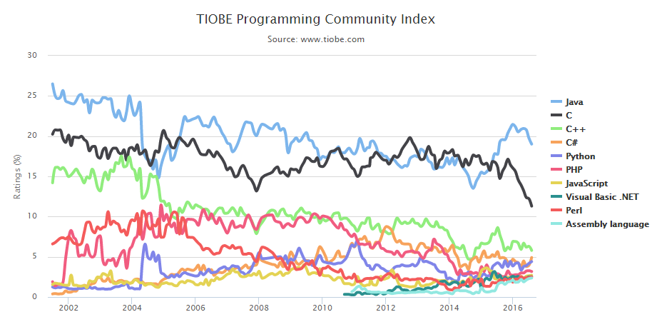
Java
“Most popular” programming language
Write once, run anywhere
Object oriented
Robust Language
…

Slide 26
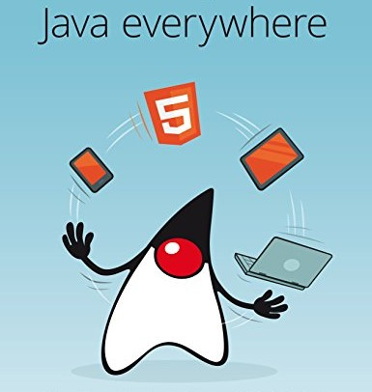
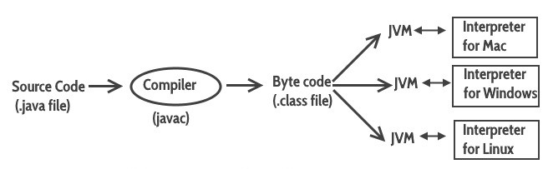
Write once, run anywhere!
Java virtual machine (JVM) is an abstract computing machine that enables a computer to run a Java program.

Slide 27
Write once, run anywhere!
Java Runtime Environment (JRE) is a software package that contains what is required to run a Java program. It includes a Java Virtual Machine implementation together with an implementation of the Java Class Library.
Java Development Kit (JDK) is a superset of a JRE and contains tools for Java programmers, e.g. a javac compiler.

Slide 28
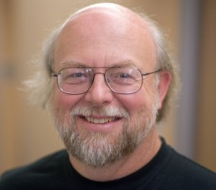
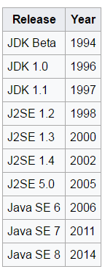


Java history
The Java platform and language began as an internal project at Sun Microsystems in December 1990.
On January 27, 2010, Sun was acquired by Oracle Corporation for US$7.4 billion.
In this course, we will use Java SE 8;
Reading materials:
https://en.wikipedia.org/wiki/Java_(software_platform)
https://en.wikipedia.org/wiki/Java_version_history

Slide 29
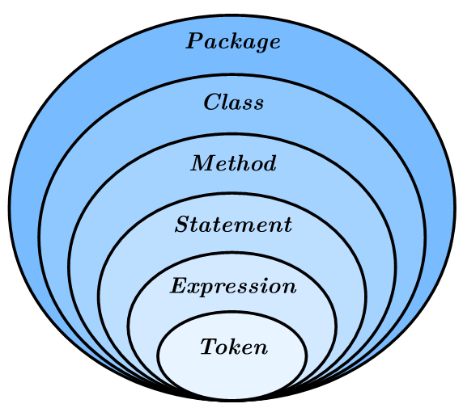
Big picture of Java
Java is an object-oriented programming language. It includes the following components.

Slide 30
Big picture of Java
A package is a collection of classes.
A class is a collection of methods (not precise).
A method is a named sequence of statements.
A statement is a line of code that performs a basic operation. A statement always ends with a semicolon (;)
An expression is a combination of tokens.
Tokens include keywords, identifiers, literals, operators, punctuation marks.
The java source code are made up of tokens and white spaces.

Slide 31
Java Program Structure
package PACKAGENAME;
public class CLASSNAME {
public static void main(String[] arguments) {
STATEMENTS
}
}
Note: The name of the class has to match the name of the file it is in.

Slide 32
Case-sensitive(大小写敏感)
Java is “case-sensitive”, which means that uppercase and lowercase are not the same.

Slide 33
1st Program
package edu.hit.java.intro;
public class Hello { public static void main(String[] arguments) { // Program execution begins here System.out.println("Hello world!"); } }
Note: This class has to be in a file named Hello.java
This program displays “Hello World!” on the screen.
Notes:
System.out.println(“Hello World!”) is a statement which print “Hello World!” on the screen!

Slide 34
1st Program
Java uses curly braces {} to group things together.
In Hello.java, the outermost braces contain the class definition, and the inner braces contain the method definition.
The line that begins with two slashes (//) is a comment, which is a bit of text in English or other language that explains the code. When the source code are translated to machine code, they will be ignored.

Slide 35
The main method
The name and format of main method is special: when the program runs, it starts at the first statement in main and ends when it finishes the last statement.
Programs can define more than one method.

Slide 36
Code Style(代码风格)
ugly!
package edu.hit.java.intro;
public class Hello { public static void main(String[] arguments) { // Program execution begins here System.out.println("Hello world!"); } }

Slide 37
Code Style
Beautiful!
package edu.hit.java.intro;
public class Hello { public static void main(String[] arguments) {
// Program execution begins here System.out.println("Hello world!");
} }

Slide 38
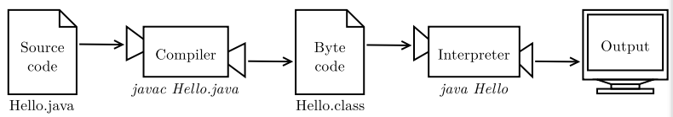
Compiling and running Java

Slide 39
Type of Errors
Compile-time error
For example, If you forget the semicolon at the end of the print statement, you might get an error message like this: File: Hello.java [line: 5] Error: ';' expected
Run-time error
For example, if you accidentally divide by zero you will get a message like this: Exception in thread "main" java.lang.ArithmeticException: / by zero at Hello.main(Hello.java:5)
Notes:
Compile-time error: It occurs when you violate the syntax rules of the Java language.
run-time error: it does not appear until after the program has started running.

Slide 40
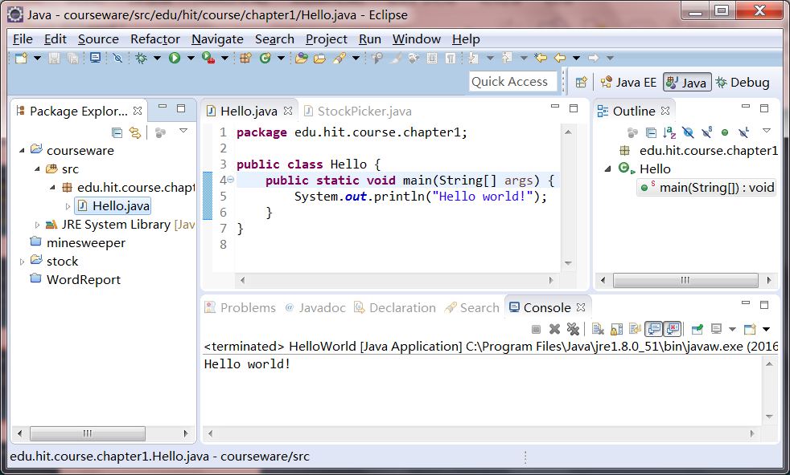
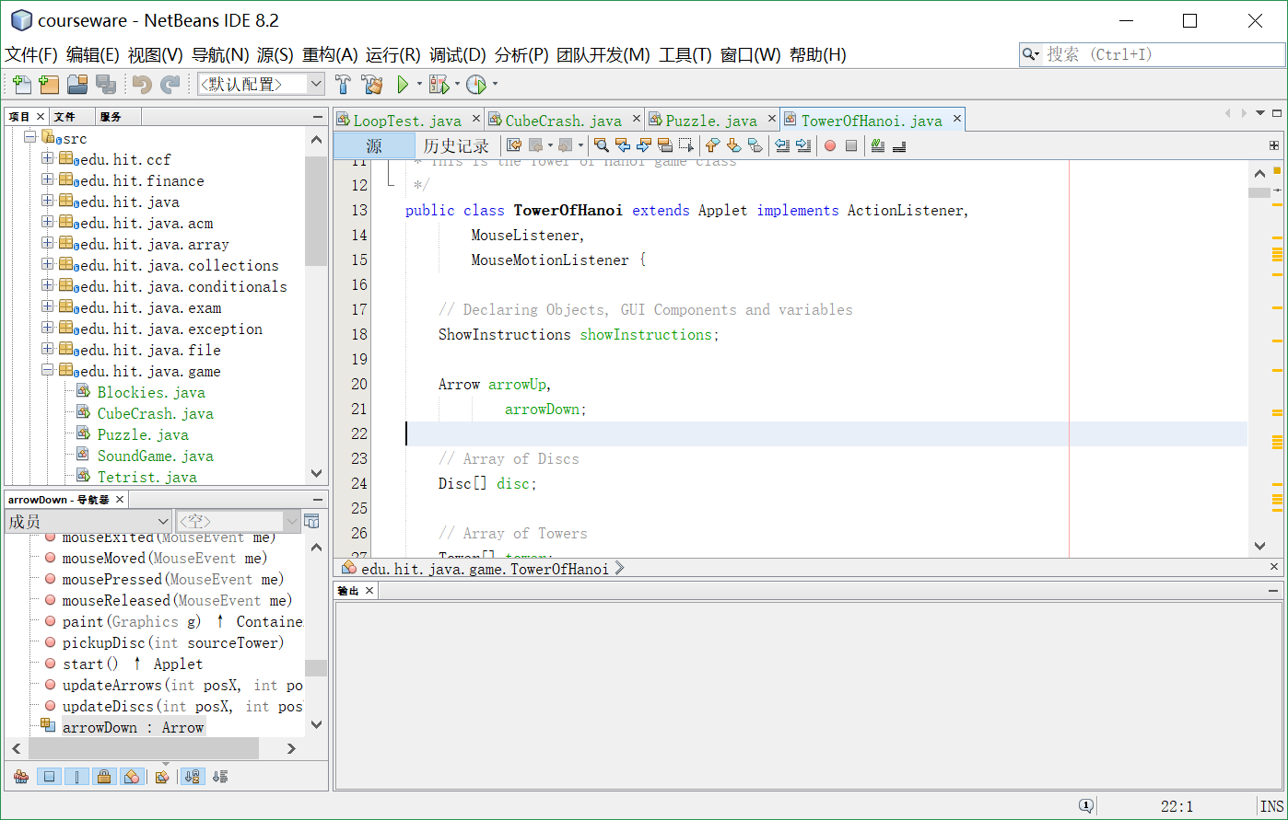
IDE(NetBeans or Eclipse)
An integrated development environment (IDE) is a software application that provides comprehensive facilities to computer programmers for software development.
An IDE normally consists of a source code editor, build automation tools and a debugger.
Most modern IDEs have intelligent code completion. Some IDEs, such as NetBeans and Eclipse, contain a compiler, interpreter.

Slide 41
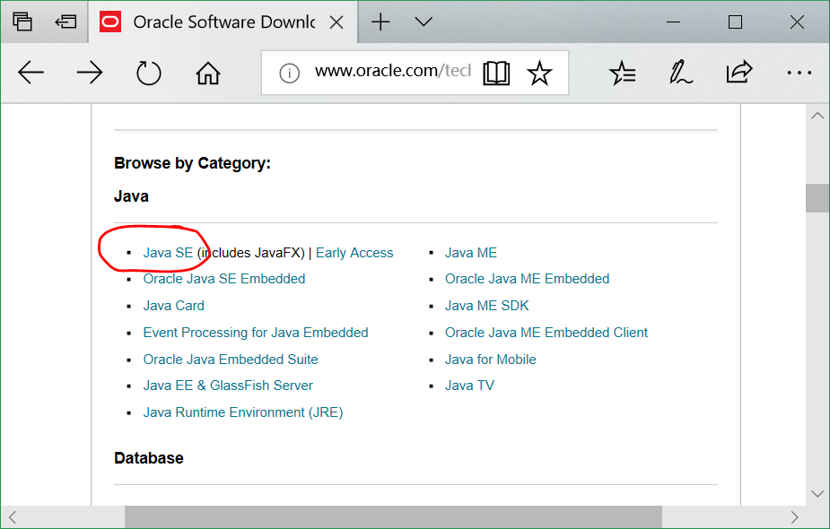
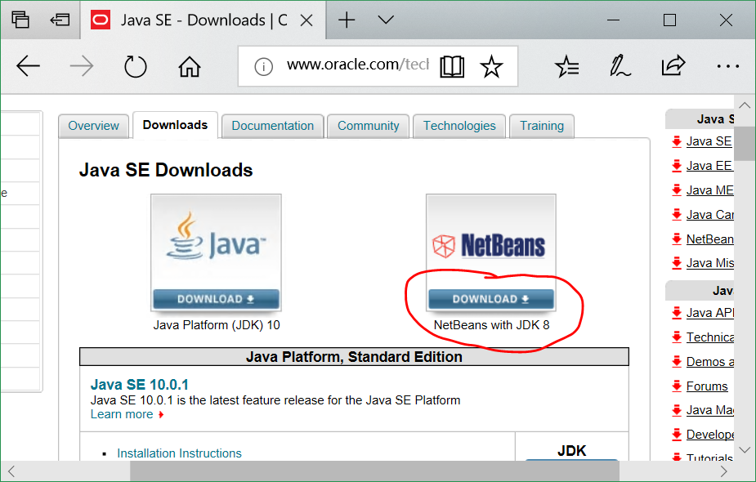
Install JDK & IDE
http://www.oracle.com/technetwork/indexes/downloads/index.html

Slide 42
Tips: shortcut keys(快捷键)
NetBeans
Ctrl + \ code tips
Ctrl + / Add/remove comment lines
Alt + Enter highlight the selected code block
Alt + Shift + F format the code
Alt + mouse wheel zoom text in/out
Shift + F6 run this java file
Ctrl + B jump to the declaration
Ctrl + R rename
‘sout’ + Tab generate System.out.println(“”)
‘for’ + Tab generate for statement
‘psvm’ + Tab generate the main method
…
Notes:
https://netbeans.org/kb/73/java/editor-codereference.html#editor-features
http://www.codejava.net/ides/netbeans/16-netbeans-shortcut-keys-for-code-editing
http://www.codejava.net/ides/eclipse/25-eclipse-shortcut-keys-for-code-editing
Eclipse
Ctrl + I
Ctrl + /
Ctrl + Shift + /
Ctrl + Shift + \
Ctrl + Shift + F

Slide 43
Demo

Slide 44


